Slide 1



Car Safety
Instructor - Dr. Marek Perkowski
Team Members:
Amulya Huchachar Aniruddha shahapurkar

Slide 2
Objectives
To have a camera mounted vehicle to detect it’s environment to make future decisions about it’s path.
Controlling vehicle motion and directions to avoid collisions by monitoring relative speed, position and direction of other vehicles.

Slide 3
Problems and Challenges
Improvement in speed of the vehicle
Taking smooth turns on curvy roads
Making a decision of taking turns and moving forward or stopping vehicle based on the detection of other vehicles and space availability.

Slide 4
Tools & Technologies
Viking bot with Sensor and Camera to undistort the incoming image frames using camera calibration.
Open CV
Image processing is used for getting a live stream input frames, detecting lanes and cars.
Python/C++ as scripting language

Slide 5
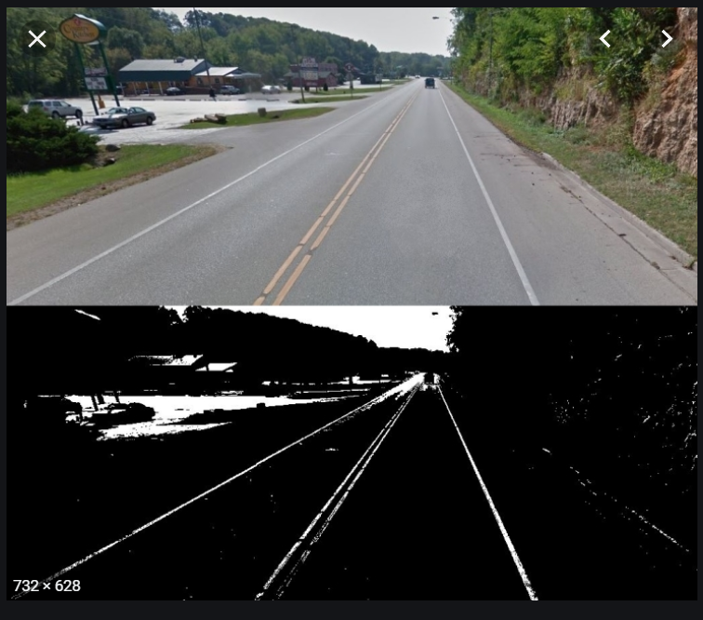
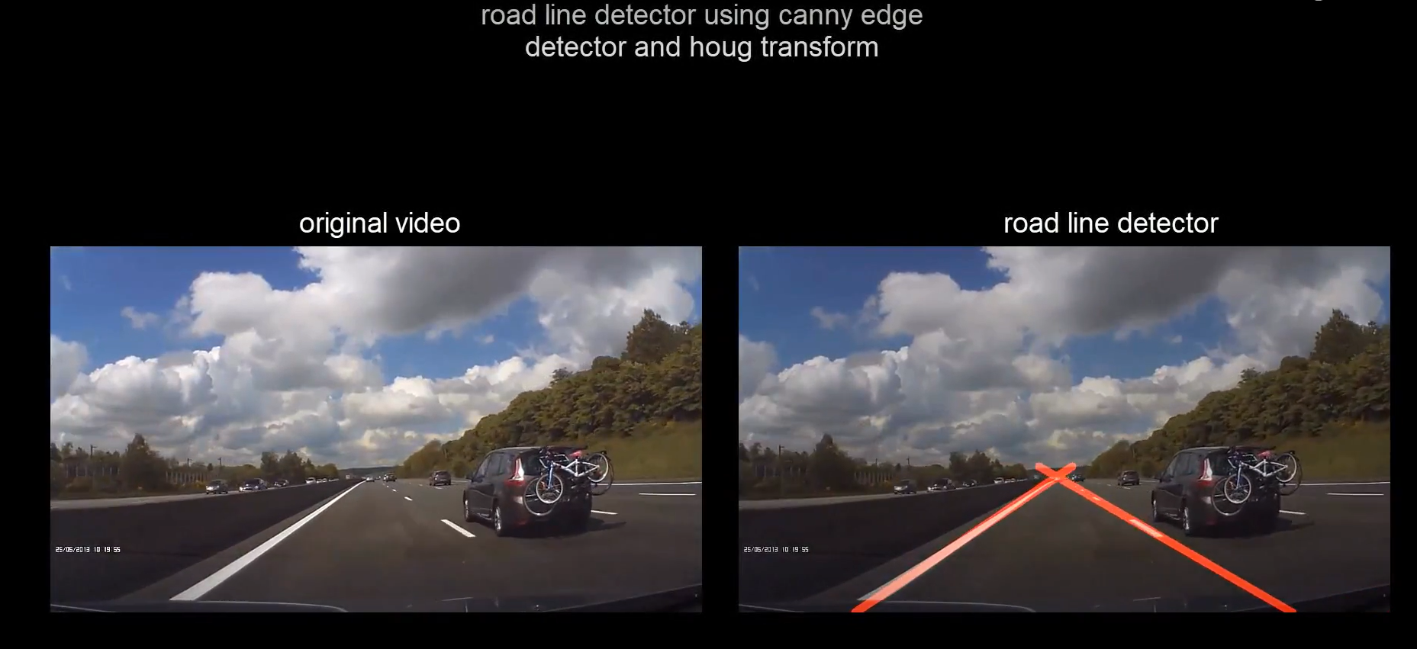
Algorithm
Gaussian Blur :
Used to smooth or blur the image to get rid of noise.
Canny Edge Detection:
This algorithm detects edges in an input image and converts the image into an “edge image”.
Hough Transforms :
The Hough transform is a method for finding lines, circles or other simple forms in an image.

Slide 6
Algorithm
RANSAC(Random Sample Consensus) :
To find the best candidate points for the vanishing point.
Plane-to-plane Homography :
To convert the frames to a birds-eye-view.

Slide 7
Future Goals
To provide auditory alerts to users about potentially hazardous vehicles
Detecting the traffic signals and taking appropriate decisions accordingly.

